Slide 1
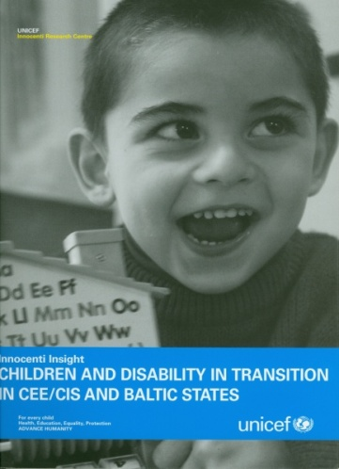
Illusion or Inclusion? Living an ‘ordinary’ life for children with disabilities
Professor Monica Dowling,
Faculty of Health and Social Care
The Open University, UK

Slide 2
Two Qualitative Studies
Study 1(S1) – UNICEF sponsored study of children with disabilities in BiH and Bulgaria - focus for this presentation on institutional care
Study 2 (S2) – Open Society funded participative project with parents in BiH and Croatia

Slide 3
History in Eastern Europe
Influence of Communism including ideologizing of childhood e.g. Young Pioneers – disabled children were never part of this picture
Collective care and removal of disabled children from families to institutions ,
Social problems were hidden – public not aware
Power of professionals/medical model

Slide 4
Croatian Mother – study 2
What they told me was very very negative. They said my child will never be able to walk and gave her an autism diagnosis
Parents in BiH and Croatia felt they were battling with bureaucracy and professional authority in wanting to keep their child living with them

Slide 5
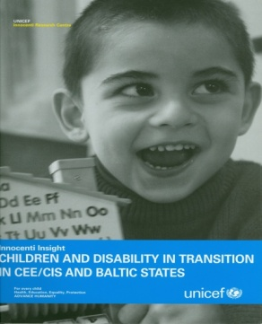
Theories of Social exclusion
The social model of disability – not well known or understood in S1 or S2
The Sociology of childhood – social construction of childhood in institutional care in S1
Children’s rights- UN Convention on the Right of the Child (UNCRC 1989) and UN Convention on the Rights of Persons with Disabilities (2006) – part of EU accession discourse

Slide 6
Questions
How can children with disabilites live an ‘ordinary’ life?
Does UNCRC apply or do children with disabilities have more rights?
How do we disentangle rights from reasonable adjustments ?

Slide 7
Inclusion - views of professionals
‘Policy makers want to close down special schools, but soon they will realise that inclusion does not work and they will need to rebuild special schools again’ (teacher, special school Bulgaria)
Professionals and social care workers in special schools and residential institutions are often left out of inclusion initiatives
Professionals in B&H and Bulgaria doubted if inclusion is for all children
Where are the specialists for inclusion in special and integrated schools and residential institutions?

Slide 8
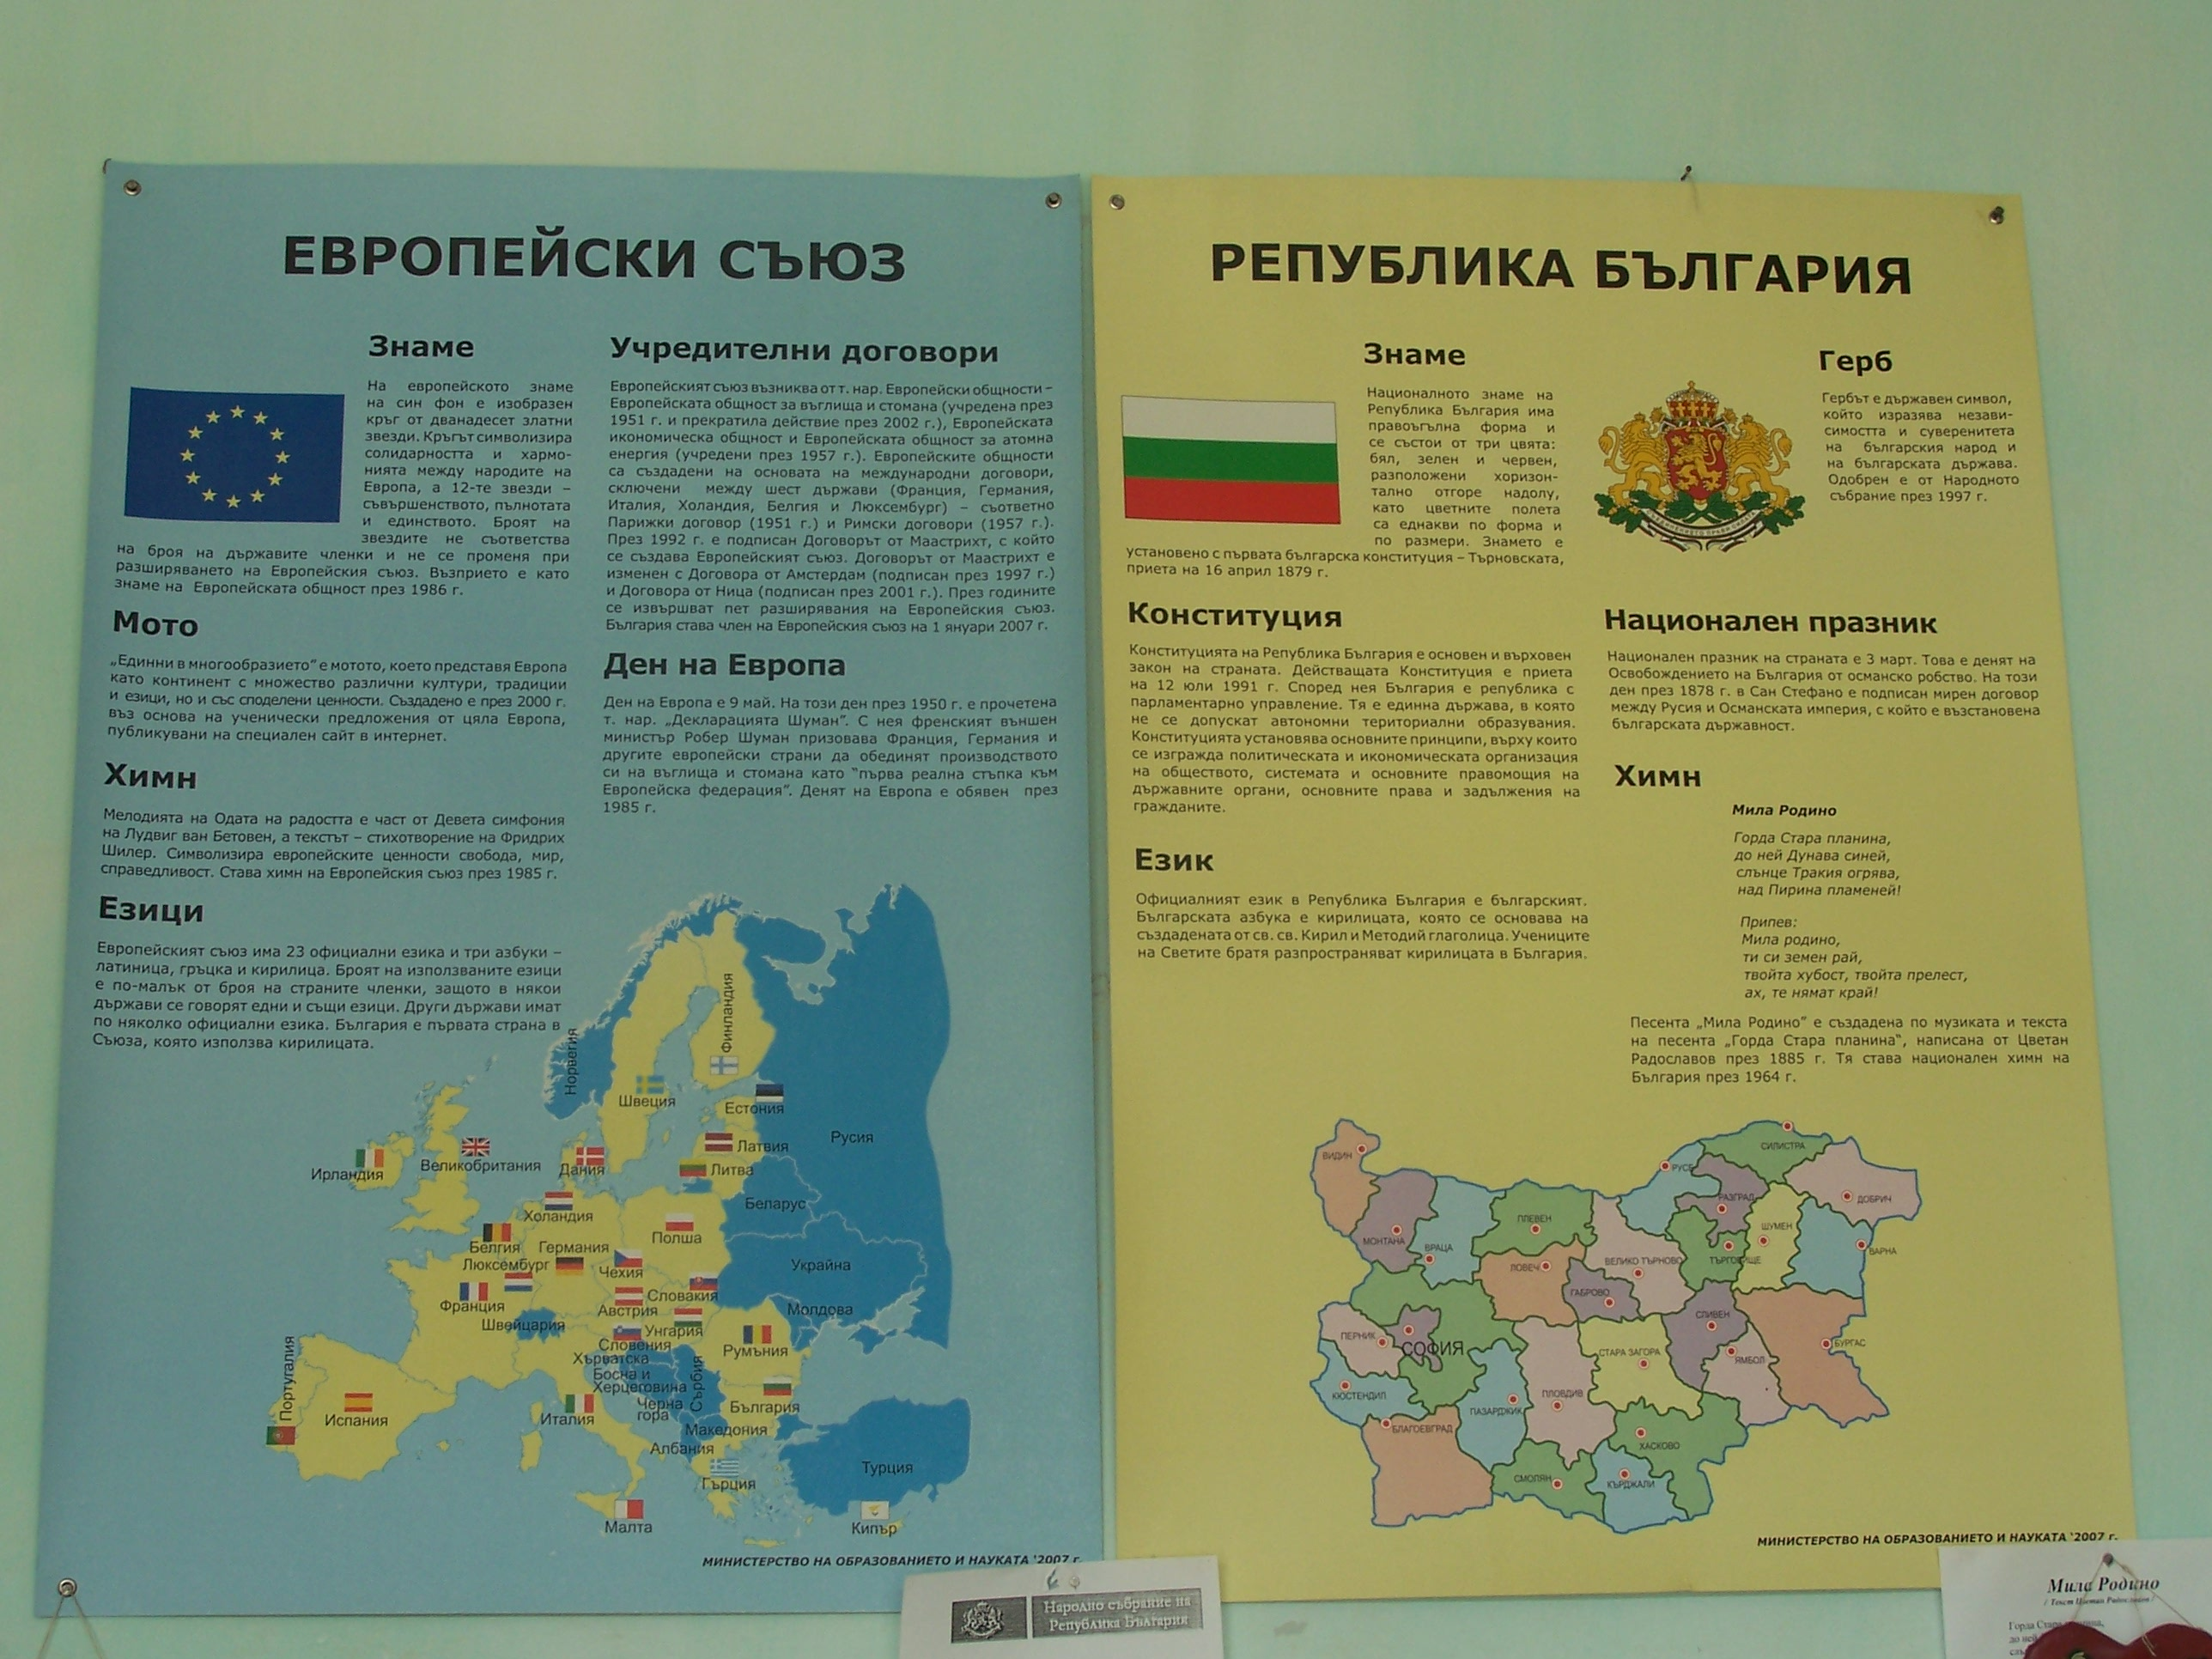
Poster from one Bulgarian special school
Influence of the EU inclusion agenda

Slide 9
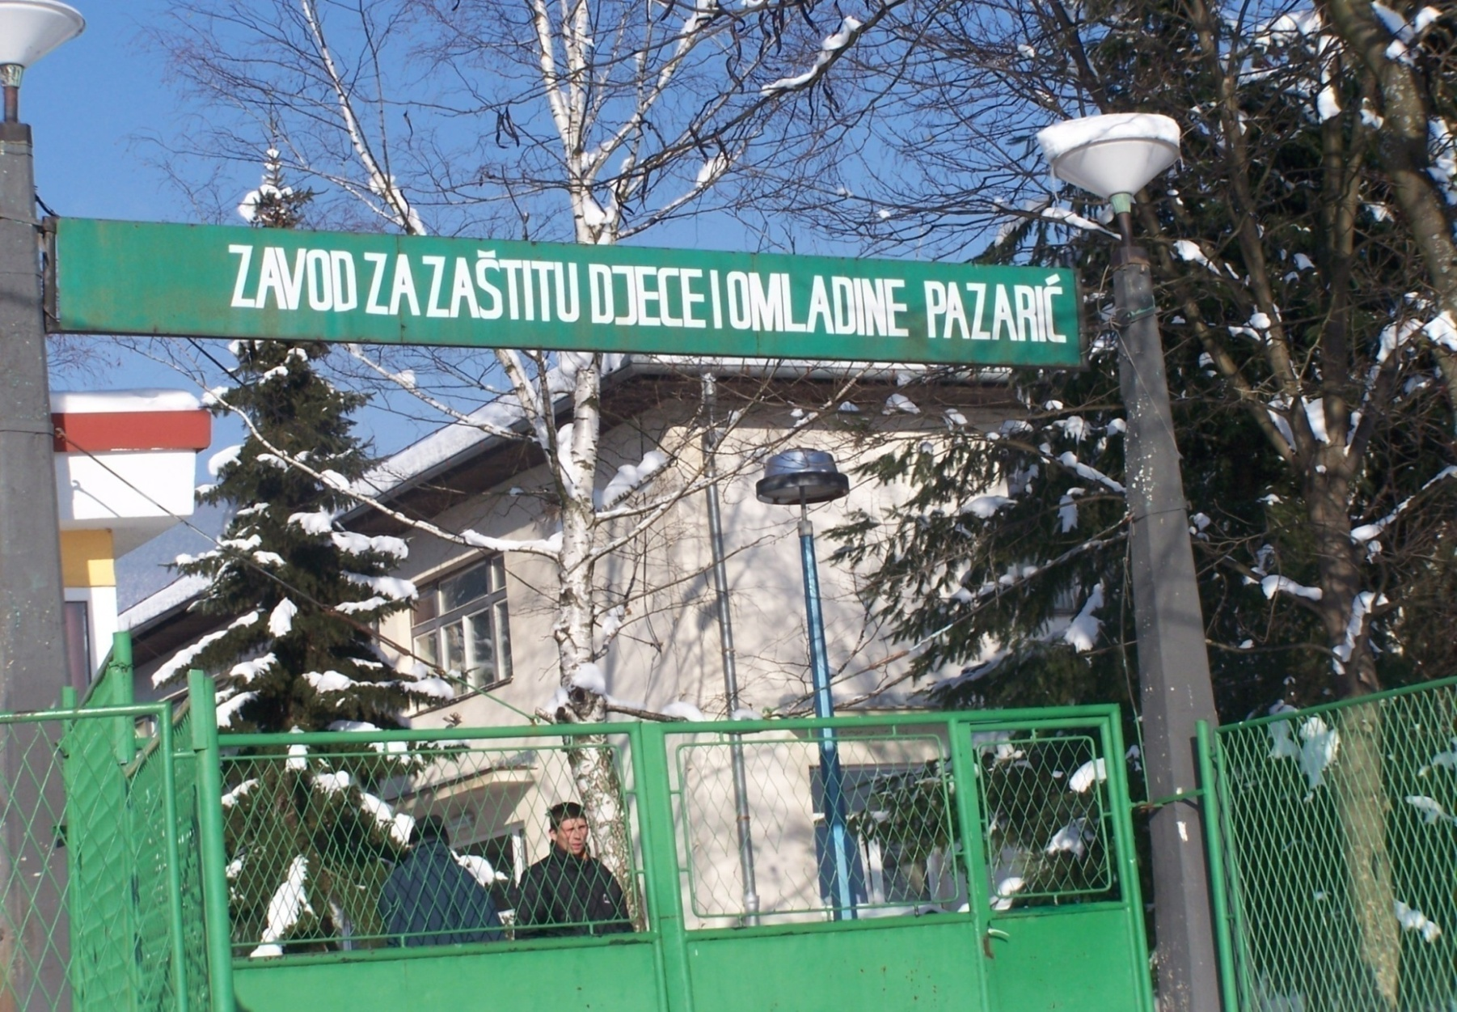
Zavod Breziljek

Slide 10
An ‘ordinary’ life ? Study 1
‘I am so happy here, as if I was born here. I have my privacy here… I passed this year with very good grades in school, it was impossible before…You know, for me this house is like a haven’. (Mirza, 12 years of age, previously living in an institution, now in a foster home - B&H)
Iva experienced rejection at the mainstream school in her small town in Bulgaria. Her family moved to Sofia to access a day centre and a better resourced mainstream school (Bulgaria, 9 year old girl)

Slide 11
An ‘ordinary life’ can be facilitated by:
Resources by government and international NGOs to provide training and development for professionals and social care staff in institutions
(Recommendation S1)
Examining inclusion through the experiences of children, parents and professionals in order to understand the changes that are, or are not, taking place (Recommendation S2)

Slide 12
Professor Monica Dowling Professor of Social Work , The Open University Monica.Dowling@open.ac.uk Dr Majda Becirevic Researcher, The Open University , Faculty of Health and Social Care The Open University Walton Hall Milton Keynes MK7 6AA

